Slide 1
gRPC
.NET Core 3.0 +

Slide 2
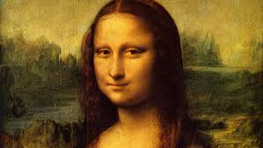
The world of services

Slide 3
What is RPC?
RPC – Remote Procedure Call
Enables communication between client and server.
Used in most distributed systems.
It solves the following problems: security, synchronization, data flow handling, etc.
Examples: WCF, JSON-RPC, SOAP, Apache Thrift, CORBA, Apache Avro, gRPC, NFS, D-Bus

Slide 4
What is gRPC?
RPC framework
Classic RPC & streaming RPC
Multilanguage: C#, Java, Go, C, C++, Node.js, Python, Ruby, Objective-C, PHP and more.
IDL: Protocol Buffers 3, Flatbuffers
Transport layer: HTTP2
Security: SSL/TLS
Open source: https://github.com/grpc/

Slide 5
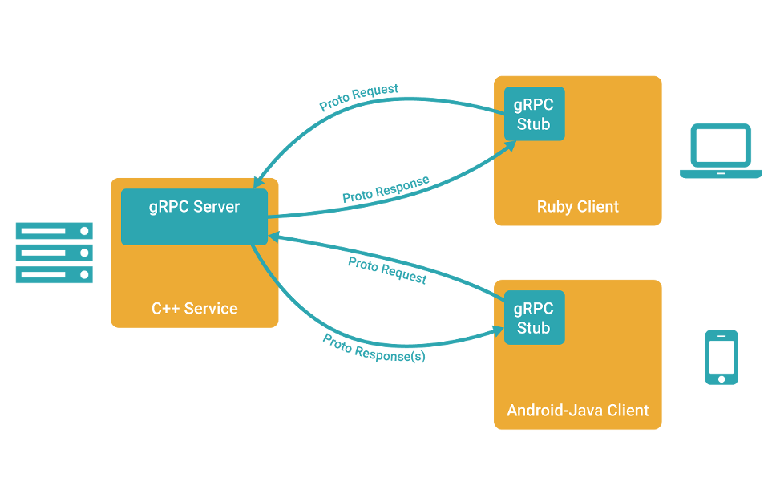
Source: https://grpc.io/
Notes:
Zdroj: https://grpc.io/

Slide 6
What does it bring / when to use it?
Effective communication between services built on one or more different architectures and programming languages.
Communication of mobile devices or browsers with the server.
Easy generation of client libraries.
Low latency, high scalability (ideal for distributed systems).
Replacement for WCF in .NET Core.

Slide 7
What are „Protocol Buffers“?
Binary serialization protocol developed by Google.
Open source since July 2008.
Platform independent.
High performance.
Low CPU and memory requirements.
Small size = low data transfer.
They use * .proto files to describe the interface.
https://developers.google.com/protocol-buffers

Slide 8
How does the * .proto file look like?
syntax = "proto3";
option csharp_namespace = "MyBlog";
package myArticleService;
service Article {
rpc Add (AddRequest) returns (AddReply);
rpc Delete (DeleteRequest) returns (DeleteReply);
}
message AddRequest { string title = 1; string body = 2; }
message AddReply { int32 id = 1; string status = 2; }
message DeleteRequest { int32 id = 1; }
message DeleteReply { string status = 1; }
https://developers.google.com/protocol-buffers/docs/proto3

Slide 9
What is the purpose of the * .proto file?
Language-independent interface description.
Generating code for server and client.
To generate the code, you need a generator for the target language: https://github.com/protocolbuffers/protobuf/releases/
Visual Studio can generate code using the NuGet package "Grpc.Tools": https://www.nuget.org/packages/Grpc.Tools/

Slide 10
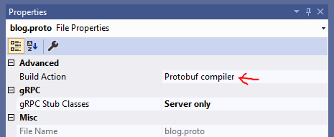
gRPC server
gRPC is implemented in .NET within ASP.NET Core.
NuGet package "Grpc.AspNetCore".
It is a standard ASP.NET Core application.
The base code is generated by Grpc.Tools.
You need to create a service that inherits from the generated class "XyzBase" ("Xyz" is the name of the service in the * .proto file) and implements the individual methods from the. * Therefore file.
In ASP.NET Core it is necessary to register the gRPC service:
And to register the middleware taking care of the service created by us:
services.AddGrpc();
endpoints.MapGrpcService<BlogService>();

Slide 11
gRPC client
Any .NET application.
NuGet package "Grpc.Net.Client" + "Google.Protobuf".
The client code generates the "Grpc.Tools" package.
The client is represented by the XyzClient class (Xyz is again the name of the service in the * .proto file).
var channel = GrpcChannel.ForAddress("https://localhost:5001");
ArticleClient client = new ArticleClient(channel);
AddReply res = await client.AddAsync(new AddRequest() {
Title = "Název článku",
Body = "Text článku"
});

Slide 12
Mapping C # to * .proto
Description of mapping of individual data types: https://docs.microsoft.com/en-us/aspnet/core/grpc/protobuf

Slide 13
Metadata
Requests can include metadata that is physically sent as HTTP headers.
They can be used, for example, for token authentication / authorization.
string authToken = "...";
Metadata meta = new Metadata();
meta.Add("Authorization", "Bearer " + authToken);
meta.Add("X-MyHeader", "my value");
ArticleClient client = new ArticleClient(channel);
AddReply res = await client.AddAsync(new AddRequest() {
Title = "Název článku",
Body = "Text článku"
}, meta);

Slide 14
Authentication
gRPC works over HTTP 2 protocol = any authentication that works within HTTP 2 protocol can be used.
X509Certificate2 certificate = ...;
var handler = new HttpClientHandler();
handler.ClientCertificates.Add(certificate);
var channel = GrpcChannel.ForAddress("https://localhost:5001", new GrpcChannelOptions()
{
HttpHandler = handler
});
ArticleClient client = new ArticleClient(channel);

Slide 15
Streaming gRPC
Allows you to send data "sequentially". So as a "stream".
You need to use the keyword "stream" in the file.
syntax = "proto3";
option csharp_namespace = "MyPointProcessor";
package myPointProcessor;
service PointProcessor {
rpc Distance (stream LineRequest) returns (stream DistanceReply);
}
message Point { int32 x = 1; int32 y = 2; }
message LineRequest { Point a = 1; Point b = 2; }
message DistanceReply { float distance = 1; }

Slide 16
Streaming gRPC - client
var channel = GrpcChannel.ForAddress("https://localhost:5001");
PointProcessorClient client = new PointProcessorClient(channel);
AsyncDuplexStreamingCall<LineRequest, DistanceReply> distanceStream = client.Distance();
Task generatorTask = Task.Run(async () =>
{
Random rand = new Random();
for (int i = 0; i < 5; i++)
{
await distanceStream.RequestStream.WriteAsync(new LineRequest()
{
A = new Point() { X = rand.Next(0, 30), Y = rand.Next(0, 30) },
B = new Point() { X = rand.Next(0, 30), Y = rand.Next(0, 30) }
});
await Task.Delay(1000);
}
await distanceStream.RequestStream.CompleteAsync();
});
while (await distanceStream.ResponseStream.MoveNext())
{
Console.WriteLine(distanceStream.ResponseStream.Current.Distance);
}
await generatorTask;

Slide 17
Streaming gRPC - server
public class PointProcessorServiceService : PointProcessorBase
{
public override async Task Distance(IAsyncStreamReader<LineRequest> requestStream,
IServerStreamWriter<DistanceReply> responseStream, ServerCallContext context)
{
while(await requestStream.MoveNext())
{
await responseStream.WriteAsync(new DistanceReply() {
Distance = GetDistance(requestStream.Current.A, requestStream.Current.B)
});
}
}
private float GetDistance(Point x, Point y)
{
return (float)Math.Sqrt(Math.Pow(x.X - y.X, 2) + Math.Pow(x.Y - y.Y, 2));
}
}

